Slide 1


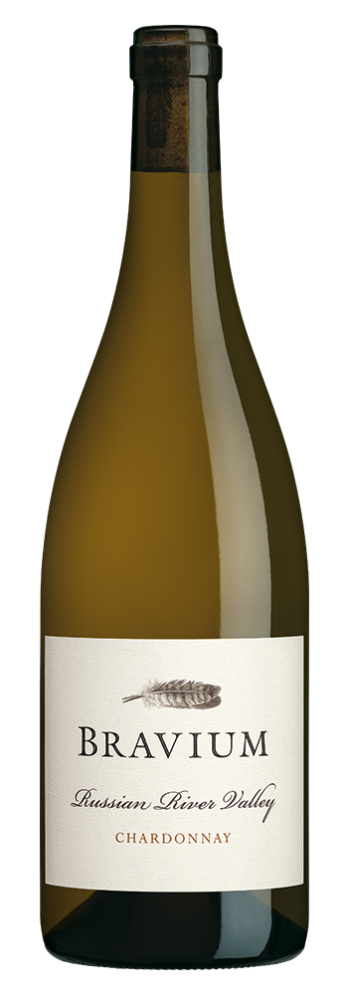
CHARDONNAY
2025
VINEYARD INFORMATION:
Plumis Vineyard is Bravium's estate Chardonnay planting, located on the north side of the Russian River near the small town of Forestville. This low-lying site is regularly blanketed by fog and winds that originate in the nearby Pacific Ocean, which slows ripening and provides balanced acidity in our wines. 90 acres are planted to a wide variety of Chardonnay vines, including selections that originated at Stony Hill Vineyard. Dijon clones make up the balance of the vineyard, with nine distinct blocks planted in 2001 and 2003. The Chardonnay grown in this vineyard reaches its highest potential, thanks to its unique microclimate, soil, and exposure.
2025 GROWING SEASON:
Favorable, cool conditions at the start of the growing season in Russian River Valley were followed by a long, consistent growing season with no major heat events. A mild summer allowed grapes to mature gradually, with relatively low temperatures continuing into the harvest period. The moderate climate and steady ripening enhanced site expression, and our Chardonnay lots showed exceptional structure and energy. I am fortunate to grow grapes in such close proximity to the Pacific Ocean and its moderating influence. My Chardonnay grape yields were reduced but quality was excellent in 2025, a vintage that was similar to the standout 2023 growing season.
INGREDIENTS: Hand Harvested Grapes, Torulaspora Delbrueckii and Indigenous Yeasts, Naturally Occurring Malolactic Bacteria, Oak from Barrel Aging, SO2
WINEMAKER COMMENTS:
This vivacious wine perfectly reflects the cool-climate Russian River Valley vineyard where it was grown as well as the historically moderate 2025 vintage. Brilliant yellow-gold color, with honey, pear, apple, pineapple, clove, saltwater taffy, damp soil, and white flower aromas, with just a hint of oak spice. The wine opens brightly with ripe fruit that transitions from citrus - lemon - to apple, pear, and nectarine fruit on the medium-bodied mid-palate. Invigorating acidity and an intriguing nuttiness carries the fruit, vanilla, and saline notes on the persistent finish of this delicious Chardonnay.
VARIETAL:
100% Chardonnay
CLONES:
4, 76, 95, 96
APPELLATION:
Russian River Valley
HARVEST DATES:
September 5,8,9,16, 2025
RELEASE DATE:
July 2026
ALCOHOL:
13.5%
pH:
3.66
TA:
4.8 g/L
AGED:
9 months in French and Hungarian oak [15% New]
COOPERAGES:
Billon, Damy, Francois Freres, Kadar, and Taransaud
CASES PRODUCED:
22,000 6 x 750ml Cases

