Slide 1


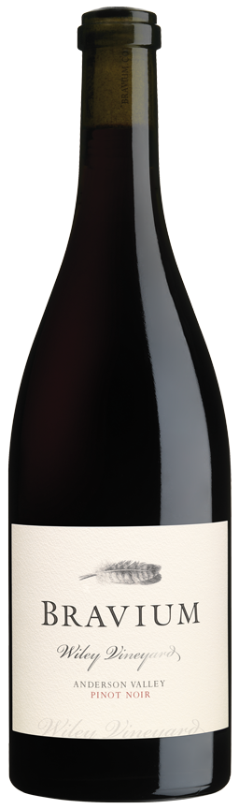
PINOT NOIR
2024
VINEYARD INFORMATION:
Vines were established at Wiley Vineyard in 1972, making it the first vineyard to be planted in the westernmost portion of Anderson Valley now commonly known as the “Deep End.” Wiley is a true cool-climate site, resting on benchlands just nine miles from the Pacific Ocean. This vineyard is renowned for its bucolic setting and finessed wines produced from 40 year old vines rooted in sandstone soils. I am honored and privileged to farm Wiley Vineyard, truly world-class terroir.
2024 GROWING SEASON:
Favorable conditions at the start of the growing season in Anderson Valley were followed by a relatively mild start to the growing season. Summertime warmth accelerated ripening in a marked way, though I am fortunate to grow grapes in such close proximity to the Pacific Ocean and its moderating influence. Pinot Noir grape yields were lighter than average and quality was excellent in 2024.
INGREDIENTS: Hand Harvested Grapes, Torulaspora Delbrueckii and Indigenous Yeasts, Naturally Occurring Malolactic Bacteria, Oak from Barrel Aging, SO2
WINEMAKER COMMENTS:
This elegant wine is a blend of my favorite twelve barrels produced from Wiley Vineyard Pinot Noir grapes in 2024. 50% whole clusters were included in small stainless-steel fermenters, with each vineyard block being fermented separately. Ruby red, with sous bois and rose petal aromas, layers of delicate red berry flavors, and sanguine, iron notes, this structured Pinot Noir is a study in judicious stem inclusion and nascent complexity. Red and blue fruits dominate the lightly grippy mid-palate of this medium-bodied, rustic wine and are joined by savory tomato and miso notes on the saline, soil-driven finish. This varietally-correct Wiley Vineyard Pinot Noir is accessible today, yet it will age gracefully for years to come.
VARIETAL:
100% Pinot Noir
CLONES:
Pommard, Swan, 2A (Wadenswil), 37, 115, 459, 538, 667, 828
APPELLATION:
Anderson Valley
HARVEST DATES:
September 17, 20, 23, 24, and 25, 2024
RELEASE DATE:
March 1, 2026
ALCOHOL:
12.3%
pH:
3.7
TA:
5.7 g/L
AGED:
10 months in French and Hungarian oak [30% New]
COOPERAGES:
Billon, Francois Freres, Kadar, Rousseau, and Taransaud
CASES PRODUCED:
498 6/750ml Cases

