Slide 1

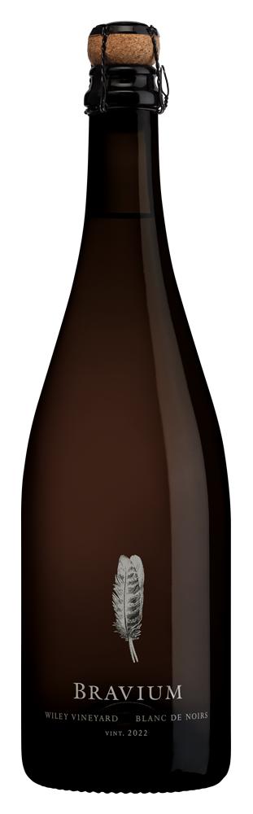
WILEY VINEYARD
BLANC DE NOIRS
2022
VINEYARD INFORMATION:
Wiley Vineyard was planted in 1972 in the famed “Deep
End”, the westernmost portion of Anderson Valley. Wiley is a true cool-climate site, resting on benchlands just nine miles from the Pacific Ocean. This vineyard is renowned for its bucolic setting and elegant, finessed wines from 45 year old vines. I am honored to farm Wiley Vineyard, truly world-class terroir.
GROWING SEASON:
The 2022 growing season will be remembered for its continuing drought conditions, uneven fruit set, and September heat and rain events. The small crop showed an elevated amount of natural acidity and fresh fruit flavors. I am fortunate to be growing grapes in such close proximity to the Pacific Ocean and its moderating influence. Grape yields were substantially below historical averages and quality was good in this vintage.
WINEMAKER COMMENTS:
This single site Brut Nature sparkling wine was bottled unfined and unfiltered. It is a wine that transparently speaks of a special place and a specific vintage, an expression inspired by my favorite Grower Champagnes and zero dosage bottlings.
Brilliant, light copper color. Lively ripe peach, cherry, mandarin orange, and apple fruit with a sweet custard backing. Hints of orange peel and rhubarb mingle with the bright, fresh fruit and saltwater taffy. Vivacious and fresh. Texturally rich with savory bouillon and miso notes as well as saline acidity that is resolved and well-integrated. Pure, dynamic, and finessed with a dry but quenching finish that is exceptionally flavorful and persistent. This vinous expression is already showing the lightly autolytic character you would expect from a reserve wine that has aged much longer. This is the result of fermenting and aging the base wine on the lees for ten months in neutral oak barrels before tirage bottling, effectively fast-forwarding the aging process. Enjoy!
VARIETAL:
100% Pinot Noir
APPELLATION:
Anderson Valley
HARVEST DATES:
September 9, 2022
RELEASE DATE:
June 1, 2025
ALCOHOL:
12.5%
pH:
3.2
TA:
6.1 g/L
RS:
0.5 g/L
BARRELS:
Used French oak
COOPERAGES:
Damy and Taransaud
CASES PRODUCED:
601 6/750 mL, 3,606 bottles produced

