Slide 1


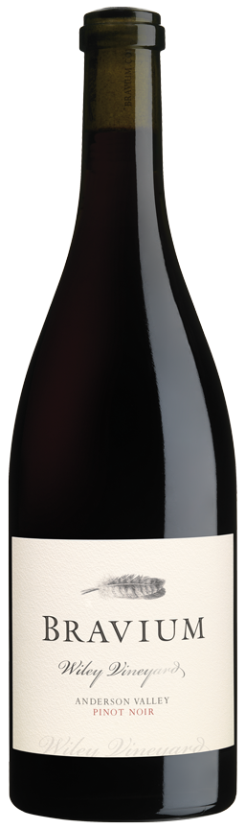
PINOT NOIR
2023
VINEYARD INFORMATION:
Vines were established at Wiley Vineyard in 1972, making it the first vineyard to be planted in the westernmost portion of Anderson Valley now commonly known as the “Deep End.” Wiley is a true cool-climate site, resting on benchlands just nine miles from the Pacific Ocean. This vineyard is renowned for its bucolic setting and finessed wines produced from 40 year old vines rooted in sandstone soils. I am honored and privileged to farm Wiley Vineyard, truly world-class terroir.
2023 GROWING SEASON:
Favorable conditions at the start of the growing season in Anderson Valley were followed by a very mild growing season that harkened back to earlier times. Following the cool early season, August warmth accelerated ripening. I am fortunate to grow grapes in such close proximity to the Pacific Ocean and its moderating influence. Pinot Noir grape yields were typical and quality was excellent in 2023, a vintage that will be fondly remembered for years.
WINEMAKER COMMENTS:
This elegant wine is a blend of my favorite barrels produced from Wiley Vineyard Pinot Noir grapes in 2023. 40% whole clusters were included in small stainless-steel fermenters, with each vineyard block being fermented separately. With rose petal aromas, layers of delicate red berry flavors, and a touch of Christmas cake spice, this delicious Pinot Noir is a study in balance and nascent complexity. Red and blue fruits dominate the lushly textured flavors and are joined by sumptuous black tea and sweet tart notes on the velvety finish. This varietally-correct Wiley Vineyard Pinot Noir is accessible today, yet it will age gracefully for years to come.
VARIETAL:
100% Pinot Noir
CLONES:
Pommard, Swan, 2A (Wadenswil), 37, 115, 459, 538, 667, 828
APPELLATION:
Anderson Valley
HARVEST DATES:
October 19, 2023
RELEASE DATE:
June 1, 2025
ALCOHOL:
12.7%
pH:
3.7
TA:
5.9 g/L
AGED:
10 months in French and Hungarian oak [33% New]
COOPERAGES:
Billon, Francois Freres, Kadar, Rousseau, and Taransaud
CASES PRODUCED:
918 6/750ml Cases

