Slide 1


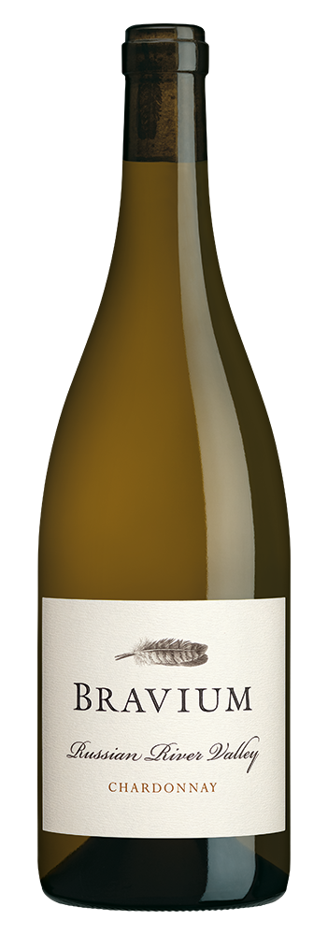
CHARDONNAY
2024
VINEYARD INFORMATION:
Plumis Vineyard is Bravium's estate Chardonnay planting, located on the north side of the Russian River near the small town of Forestville. This low-lying site is regularly blanketed by fog and winds that originate in the nearby Pacific Ocean, which slows ripening and provides balanced acidity in our wines. 90 acres are planted to a wide variety of Chardonnay vines, including selections that originated at Stony Hill Vineyard. Dijon clones make up the balance of the vineyard, with nine distinct blocks planted in 2001 and 2003. The Chardonnay grown in this vineyard reaches its highest potential, thanks to its unique microclimate, soil, and exposure.
2024 GROWING SEASON:
Favorable, cool conditions at the start of the growing season in Russian River Valley were followed by a smooth and steady growing season that delivered warm days and cool nights. Following the cool early season, Summer warmth greatly accelerated ripening. I am fortunate to grow grapes in such close proximity to the Pacific Ocean and its moderating influence. My Chardonnay grape yields were typical and quality was excellent in 2024, a vintage that will produce beautiful wines.
WINEMAKER COMMENTS:
This sumptuous wine perfectly reflects the cool-climate Russian River Valley vineyard where it was grown. Brilliant yellow-gold color, with honey, pear, apple, pineapple, clove, saltwater taffy, damp soil, cinnamon, and white flower aromas, plus a hint of oak spice. The wine opens brightly with lushly textured fruit that transitions from citrus - lemon and lime - to apple, pear, and peach fruit on the broad, full-bodied mid-palate. Invigorating acidity carries the fruit, vanilla, and saline notes on the persistent finish of this delicious Chardonnay.
VARIETAL:
100% Chardonnay
CLONES:
4, 76, 95, 96
APPELLATION:
Russian River Valley
HARVEST DATES:
September 6,7,9,10-13, 2024
RELEASE DATE:
August 2025
ALCOHOL:
14.2%
pH:
3.66
TA:
4.5 g/L
AGED:
9 months in French and Hungarian oak [17% New]
COOPERAGES:
Billon, Damy, Francois Freres, Kadar, and Taransaud
CASES PRODUCED:
18,798 6 x 750ml Cases

