Slide 1


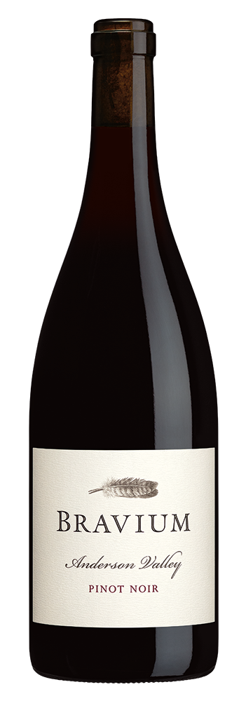
PINOT NOIR
2023
VINEYARD INFORMATION:
The foundation of this wine is Pinot Noir grown in multiple blocks at Wiley Vineyard, where vines were established starting in 1972, making it the first vineyard to be planted in the westernmost portion of Anderson Valley now commonly known as the “Deep End.” Wiley is a true cool-climate site, resting on benchlands just nine miles from the Pacific Ocean. Multiple clone/selection blocks – including 40-year-old Pommard vines – rooted in sandstone soils go into this wine. I am honored and privileged to farm Wiley Vineyard – truly world-class terroir. And the addition of grapes from Valley Foothills Vineyard in Philo as well as a smaller quantity of grapes from Helluva Vineyard near Boonville contribute floral notes and delicious red fruit flavors.
2023 GROWING SEASON:
Favorable conditions at the start of the growing season in Anderson Valley were followed by a very mild growing season that harkened back to earlier times. Following the cool early season, August warmth accelerated ripening. I am fortunate to work with grapes grown in such proximity to the Pacific Ocean and its moderating influence. Pinot Noir grape yields were typical and quality was excellent in 2023, a vintage that will be fondly remembered for years.
WINEMAKER COMMENTS:
From the far reaches of Mendocino County, this wine is prototypical Anderson Valley Pinot Noir, a delicious combination of lavender aromas, ripe fruit flavors, and sous bois elements. Brilliant ruby red in color, this Pinot Noir offers up a complex mélange of cherry cola, herbal tea, pennyroyal mint, forest floor, orange peel, and cinnamon spice. The luscious entry leads to mouth-filling cherry cola, blackberry, and dark plum flavors, with sanguine iron notes. The velvet-textured mid-palate is full of fresh fruit, with medium acidity and blueberry on the lightly saline and intriguingly savory finish.
VARIETAL: 100% Pinot Noir
CLONES: Pommard, Swan, 2A (Wadenswil), 37, 115, 459, 538, 667, 828, 943
APPELLATION: Anderson Valley
HARVEST DATES: October 3-6,13 and 16 2023
RELEASE DATE: June 1, 2025
ALCOHOL: 12.9%
pH: 3.6
TA: 6.3 g/L
AGED: 10 months in French and Hungarian oak [25% New]
COOPERAGES: Billon,Damy, Francois Freres, and Taransaud
CASES PRODUCED: 8,643 6/750ml Cases

